Slide 1

Linear Model
Yeshwant Singh
yeshwant.singh@ddn.upes.ac.in
SoCS, UPES, Dehradun

Slide 2
Recap
Probability: Univariate Model – Gaussian
Probability: Multivariate Model – Gaussian
Statistic – Maximum Likelihood Estimation, Regularizer
Decision Theory - Bayesian
Information Theory - Entropy
Optimization - Stochastic Gradient Descent

Slide 3
Outline
Logistic Regression
Linear Regression
Generalized Linear Model

Slide 4
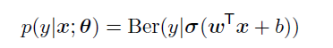
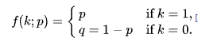
Logistic Regression
Logistic Regression
Linear Regression
Generalized Linear Model
Binary logistic regression often follows the following model
sigmoid
bias
Bernoulli
weight
$$p\left(y=1 | x;θ\right)= σ\left(a\right)=\frac{1}{1+e^{−a},} , where a=log\frac{p}{1−p}$$

Slide 5
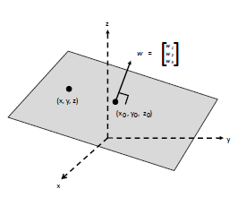
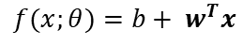
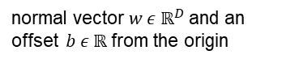
Linear Classifier
Logistic Regression
Linear Regression
Generalized Linear Model
The prediction can be written as
$$f(x;θ)=b+ w^{T}x$$
hyperplane
normal vector $w ε ℝ^{D}$and an offset $b ε ℝ$from the origin
This linear hyperplane separate 3d space into half → decision boundary
In general, there will be uncertainty about the correct class label, so we need to predict a probability distribution over labels, feed it to sigmoid function

Slide 6
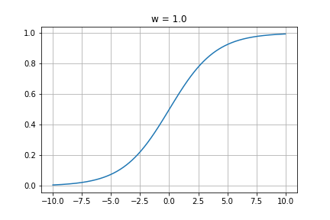
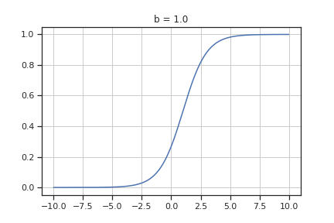
Sigmoid Function
Logistic Regression
Linear Regression
Generalized Linear Model
Sigmoid function
$$σ\left(a\right)=\frac{1}{1+e^{−a},} , where a=log\frac{p}{1−p}=b+ w^{T}x$$
Log loss and $w$ determine the steepness of the sigmoid function

Slide 7
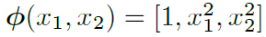
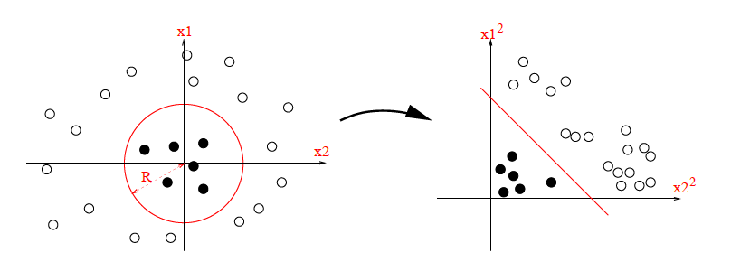
Non Linear Classifier
Logistic Regression
Linear Regression
Generalized Linear Model
Transform input features in suitable way
Decision boundary (where f(x) = 0) defines a circle with radius R

Slide 8
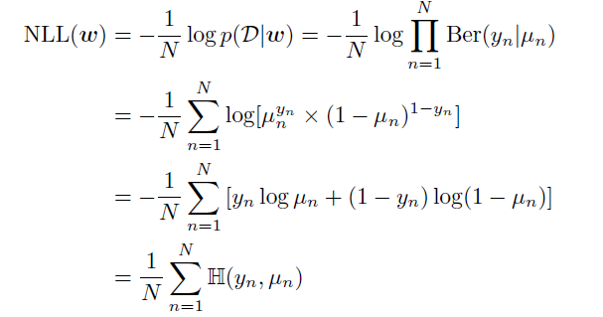
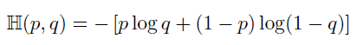
Logistic Regression – Cost Function
Logistic Regression
Linear Regression
Generalized Linear Model
Maximize Maximum Likelihood Estimation / Minimize Negative Log Likelihood
No of Sample
probability
Binary cross-entropy

Slide 9
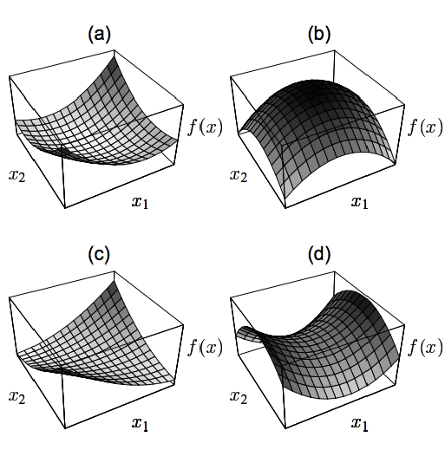
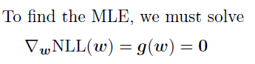
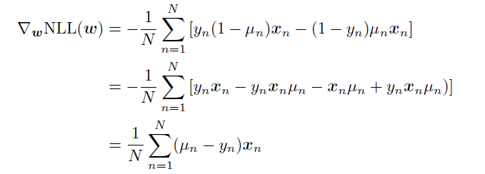
Logistic Regression – Cost Function
Logistic Regression
Linear Regression
Generalized Linear Model
Check convexity
Error
Here, we can see that the gradient is weighed by the error for each input

Slide 10
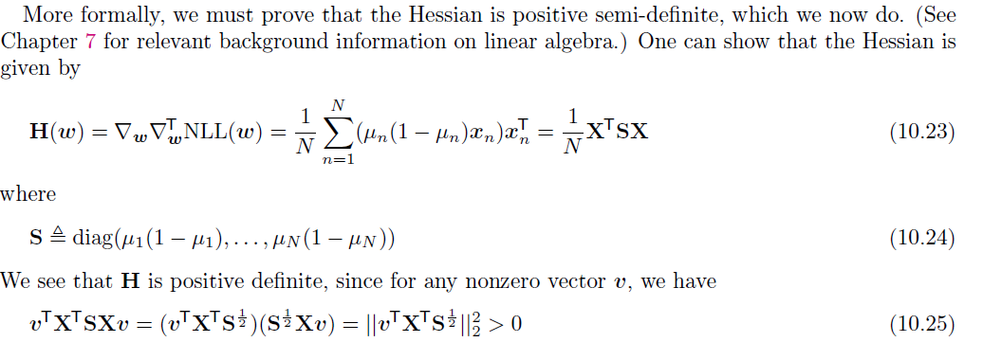
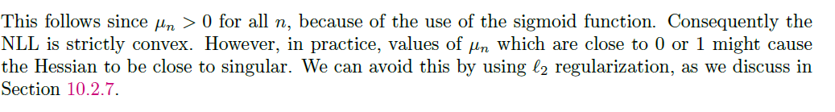
Logistic Regression – Cost Function
Logistic Regression
Linear Regression
Generalized Linear Model
Ensure NLL has bowl shape (global minimum)
→ check Hessian matrix
Check convexity

Slide 11
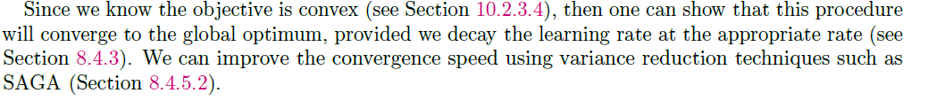
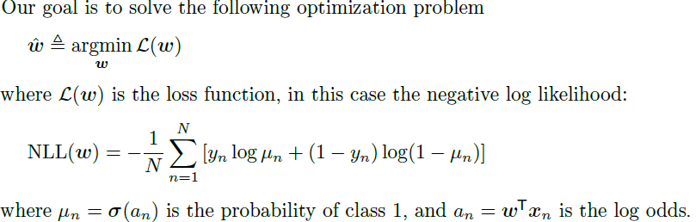
Logistic Regression – Cost Function
Logistic Regression
Linear Regression
Generalized Linear Model

Slide 12
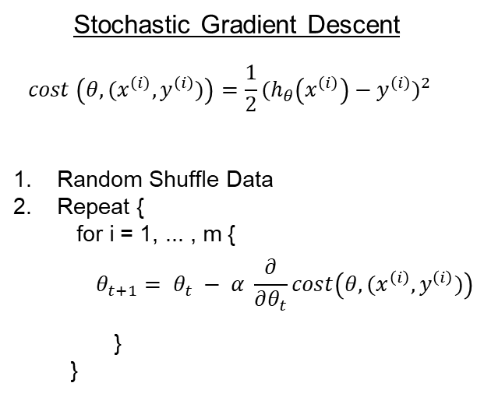

Logistic Regression – Optimizer
Logistic Regression
Linear Regression
Generalized Linear Model
First order method
Stochastic Gradient Descent
Slow convergence, when gradient is small
Second order method
Newton Method (Iteratively reweighted least squares)
$$θ_{t+1 }=θ_{k}−α\frac{1}{f^{′′}\left(θ_{k}\right)} f′(θ_{k})$$

Slide 13
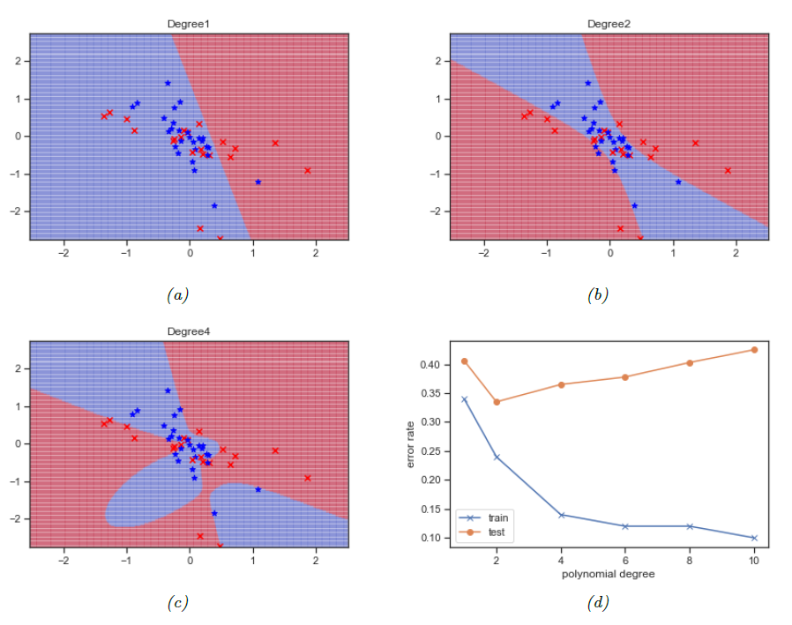
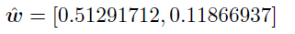
Logistic Regression – Overfitting
Logistic Regression
Linear Regression
Generalized Linear Model
See any trend?
As degree increases,
w increase / decrease?
Notes:
Two inputs weight for degree = 1

Slide 14
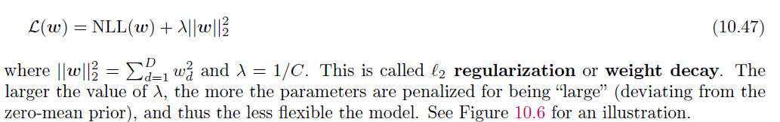
Logistic Regression – Overfitting
Logistic Regression
Linear Regression
Generalized Linear Model
Reduce Overfitting
Do not let weight to grow
Add regularizer to as penalty

Slide 15
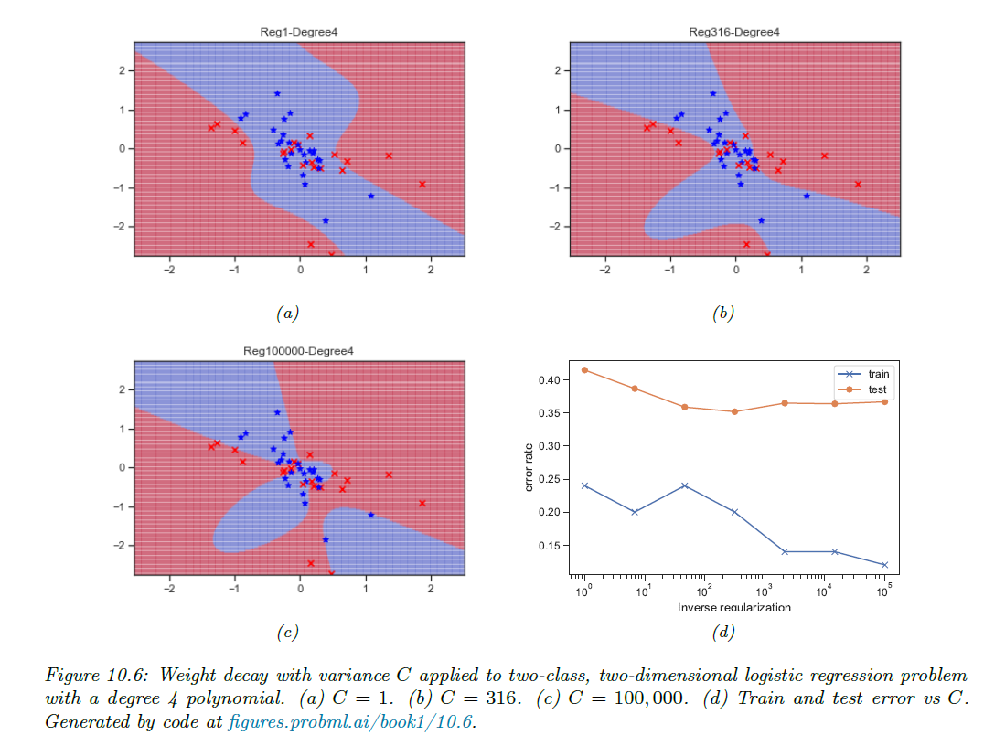
Logistic Regression – Overfitting
Logistic Regression
Linear Regression
Generalized Linear Model
Big λ / Small C → less flexible

Slide 16
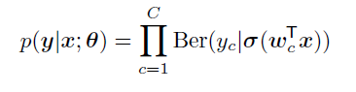
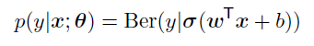
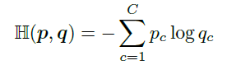
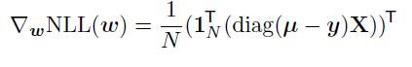
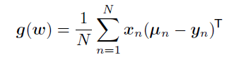
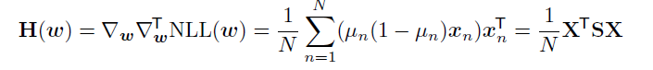
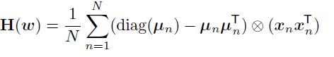
Logistic Regression – Overfitting
Logistic Regression
Linear Regression
Generalized Linear Model
Binary Logistic Regression
Multiple Logistic Regression
Probability
Activation function
σ = sigmoid activation
σ = softmax activation
Cost function
Gradient
Hessian

Slide 17
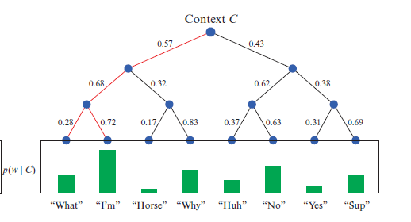
Handling large number of classes
Logistic Regression
Linear Regression
Generalized Linear Model
Using regular softmax function, when the number of classes, C increases, computational cost to compute H increases
To facilitate this, we can use hierarchy softmax
The idea behind decomposing the output layer to a binary tree was to reduce the complexity to obtain probability distribution

Slide 18
Handling imbalance class
Logistic Regression
Linear Regression
Generalized Linear Model
More attention on more ‘common’ dataset
Less attention on ‘rare’ dataset
Approach
Resample the data – Oversample / Undersample

Slide 19
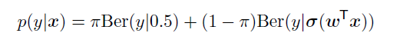
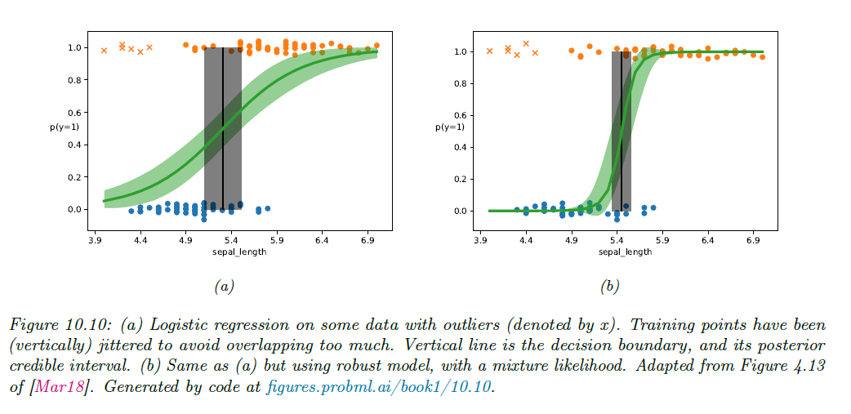
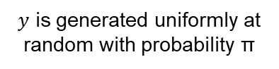
Handling outlier
Logistic Regression
Linear Regression
Generalized Linear Model
Use Mixture model for the likelihood
Otherwise, is generated using conditional model
$y$ is generated uniformly at random with probability π

Slide 20
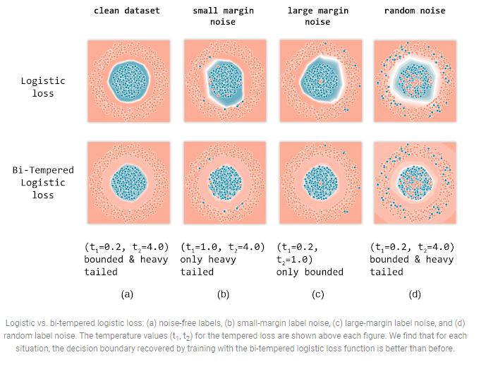
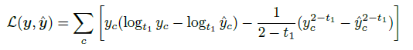
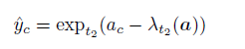
Handling outlier – Bi tempered loss
Logistic Regression
Linear Regression
Generalized Linear Model
Tempered cross-entropy
Tempered softmax

Slide 21
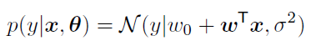
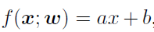
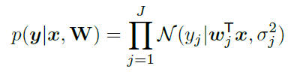
Linear Regression
Logistic Regression
Linear Regression
Generalized Linear Model
Follow the following equation
bias
Slope / weight
If input is 1-D, simple linear regression
If input is N-D, multiple/multivariate linear regression
dimension

Slide 22
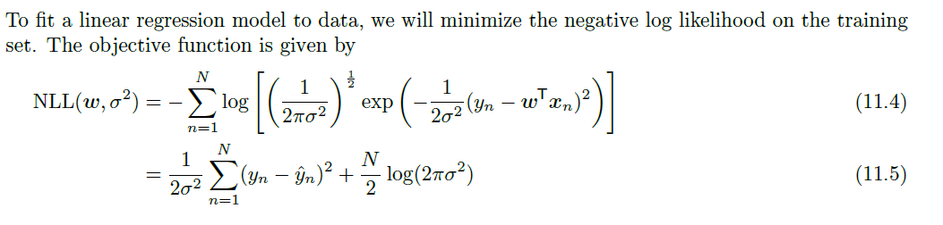
Least square regression
Logistic Regression
Linear Regression
Generalized Linear Model
weight
Gaussian
Error
Variance
The MLE is the point where $∇_{w,σ}NLL\left(w, σ^{2}\right)=0.$
We can first optimize wrt w, and then solve for the optimal σ.

Slide 23
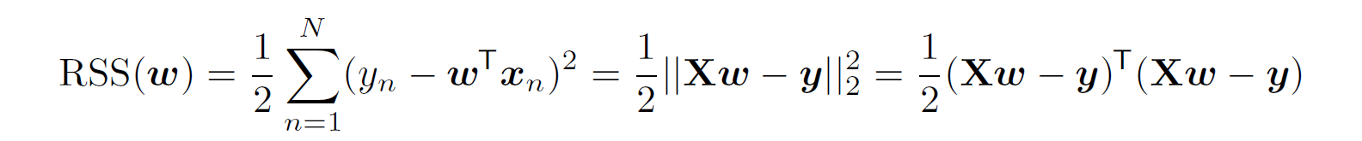



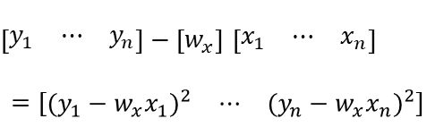
Ordinal least square – 1D
Logistic Regression
Linear Regression
Generalized Linear Model
Residual sum of square is given
$\left[\begin{matrix}y_{1} & ⋯ & y_{n}\end{matrix}\right]−\left[w_{x}\right]$ $\left[\begin{matrix}x_{1} & ⋯ & x_{n}\end{matrix}\right]$
$$=\left[\begin{matrix}{(y_{1}−w_{x}x_{1})}^{2} & ⋯ & {(y_{n}−w_{x}x_{n})}^{2}\end{matrix}\right]$$
y
y
o
o
$${(y_{1}−w_{x}x_{1})}^{2}$$
$${(y_{1}−w_{x}x_{1})}^{2}$$
o
o
o
o
o
o
o
o
x
$${(y_{5}−w_{x}x_{5})}^{2}$$
x
$${(y_{5}−w_{x}x_{5})}^{2}$$

Slide 24

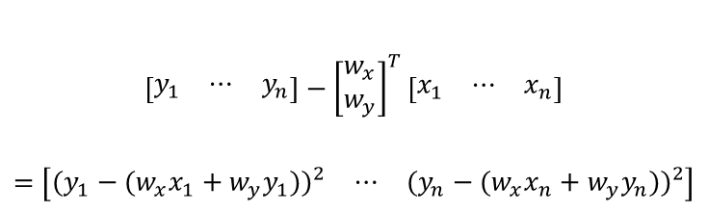
Ordinal least square – 2D
Logistic Regression
Linear Regression
Generalized Linear Model
Residual sum of square is given
$$\left[\begin{matrix}y_{1} & ⋯ & y_{n}\end{matrix}\right]−{\left[\begin{matrix}w_{x} \\ w_{y}\end{matrix}\right]}^{T}\left[\begin{matrix}x_{1} & ⋯ & x_{n}\end{matrix}\right]$$
$$=\left[\begin{matrix}{(y_{1}−{(w}_{x}x_{1}+w_{y}y_{1}))}^{2} & ⋯ & {(y_{n}−{(w}_{x}x_{n}+w_{y}y_{n}))}^{2}\end{matrix}\right]$$
Add one dimension
z
y
o
o
o
o
$${(y_{1}−{(w}_{x}x_{1}+w_{y}y_{1}))}^{2}$$
o
x

Slide 25
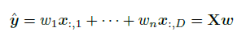
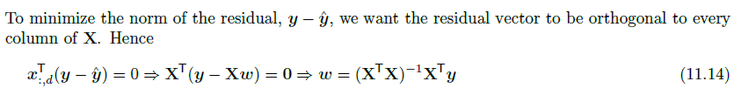
How to get w?
Logistic Regression
Linear Regression
Generalized Linear Model
Minimize RSS
We know
y
o
o
o
o
o
x
The ‘w’ can be obtained

Slide 26
Ridge regression
Logistic Regression
Linear Regression
Generalized Linear Model
Least square estimation can results in overfitting
y
Training
y
Testing
o
o
o
o
Bad
o
o
o
o
o
o
x
x
Ridge regression add a L2 regularizer to avoid overfitting (avoid very high gradient).
RSS + λ*w²

Slide 27
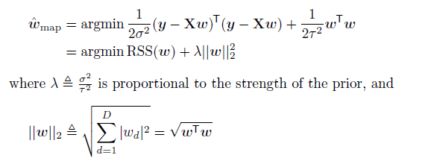
Ridge regression
Logistic Regression
Linear Regression
Generalized Linear Model
Zero λ = Least Square
Big λ
Very Big λ = 100000
y
y
y
o
o
o
o
o
o
o
o
o
o
o
o
o
o
o
x
x
x
penalizing weights that become too large in magnitude

Slide 28
How to choose lambda
Logistic Regression
Linear Regression
Generalized Linear Model
Ridge Regression add in a penalty function, L2 regularizer.
Methods:
Try with strong lambda and then softer it. Check results. → regularization path
Cross validation.

Slide 29
Lasso Regression
Logistic Regression
Linear Regression
Generalized Linear Model
y
Least square regression, RSS → less bias, high variance
o
Ridge regression, RSS + λ*w² → high bias, low variance
o
o
Ridge allows parameters to be small but cannot reach zero.
Lasso allow parameters to be exactly zero.
This is useful because it can be used to perform feature selection, where the weight of certain features can be zero.
→ Can make equation simpler
o
o
x
Lasso regression, RSS + λ*|w|
Absolute of w

Slide 30
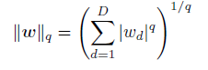
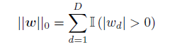
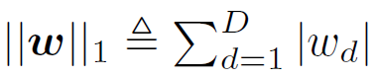

Q-norm
Logistic Regression
Linear Regression
Generalized Linear Model
General Equation
L0 loss
L1 loss
L2 loss
Elastic Net – Lasso + Ridge

Slide 31


Example - Cancer Data
Logistic Regression
Linear Regression
Generalized Linear Model
Least Square – Worst
Ridge – weight is smaller but won’t reach zero, better than LS
Lasso – some features’ weight are zero; features eliminated
Elastic Net - Best
Notes:
https://towardsdatascience.com/from-linear-regression-to-ridge-regression-the-lasso-and-the-elastic-net-4eaecaf5f7e6

Slide 32
Generalized Linear Model
Logistic Regression
Linear Regression
Generalized Linear Model
If we have the following, ordinal least square is not suitable.
Exponential graph
Variance of errors in y is not constant, and varies with X.
Response variable is not continuous, but categorical.
o
y
o
o
o
o
x
y
o
o
o
o
o
x

Slide 33


Generalized Linear Model
Logistic Regression
Linear Regression
Generalized Linear Model
We can’t use linear regression.
Variance increase with x
A suitable regression is Poisson Regression, one type of GLM model.
Notes:
https://towardsdatascience.com/generalized-linear-models-9cbf848bb8ab

Slide 34


GLM – Poisson Regression
Logistic Regression
Linear Regression
Generalized Linear Model
GLM normally made up of three components:
Linear predictor
Link function
Probability distribution –
– b0+b1x
– log link function
Poisson distribution
Notes:
https://towardsdatascience.com/generalized-linear-models-9cbf848bb8ab

Slide 35


GLM – Linear/Logistic Regression
Logistic Regression
Linear Regression
Generalized Linear Model
Linear Regression
Linear predictor – b0+b1x
Link function – identify link function
Probability distribution – Normal distribution
Logistic Regression
Linear predictor – b0+b1x
Link function – logic link function
Probability distribution – Binomial / Bernoulli distribution
Notes:
https://towardsdatascience.com/generalized-linear-models-9cbf848bb8ab

Slide 36

Custom GLM
Logistic Regression
Linear Regression
Generalized Linear Model
Relationship between x and y is not linear.
Link function = Log link function
Notes:
https://towardsdatascience.com/generalized-linear-models-9cbf848bb8ab

Slide 37
Custom GLM
Logistic Regression
Linear Regression
Generalized Linear Model
Variance seems constants
Which probability distribution for variance to choose?
Normal
Poisson
Notes:
https://towardsdatascience.com/generalized-linear-models-9cbf848bb8ab

Slide 38

Custom GLM
Logistic Regression
Linear Regression
Generalized Linear Model
Variance seems constants
Which probability distribution for variance to choose?
Normal
Poisson
Notes:
https://towardsdatascience.com/generalized-linear-models-9cbf848bb8ab

